Slide 1
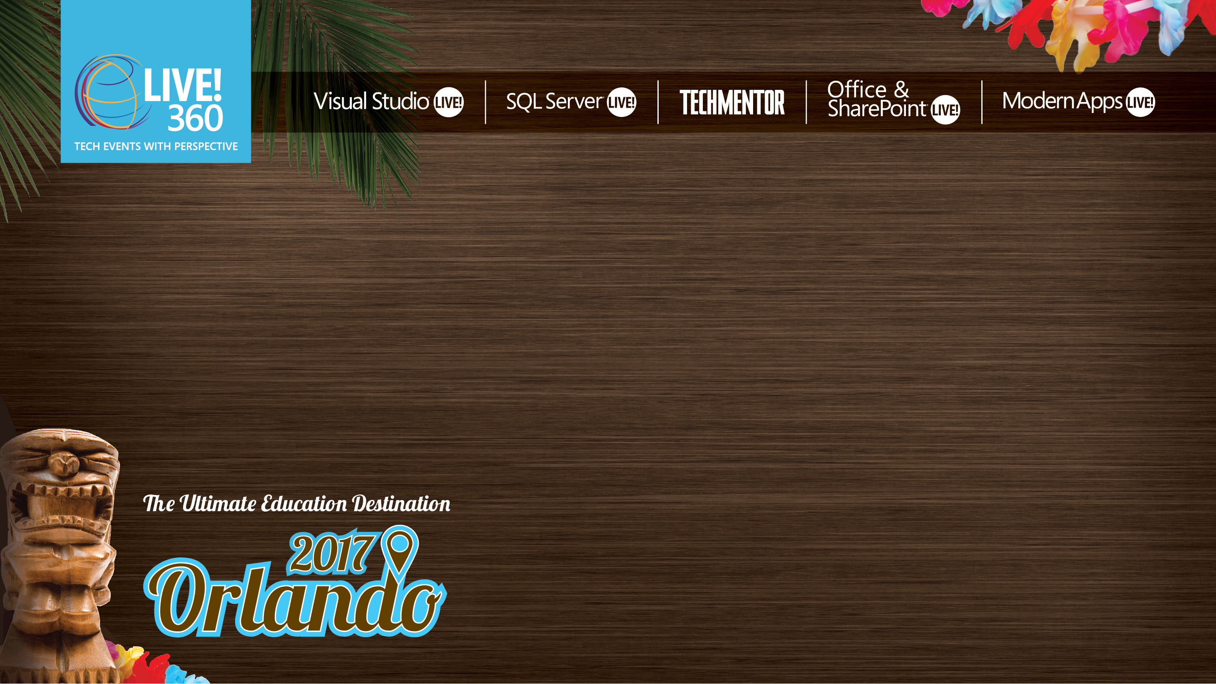
So You Think Your Code Works?
Missy Januszko
Sr. Automation Engineer
Level: Intermediate

Slide 2

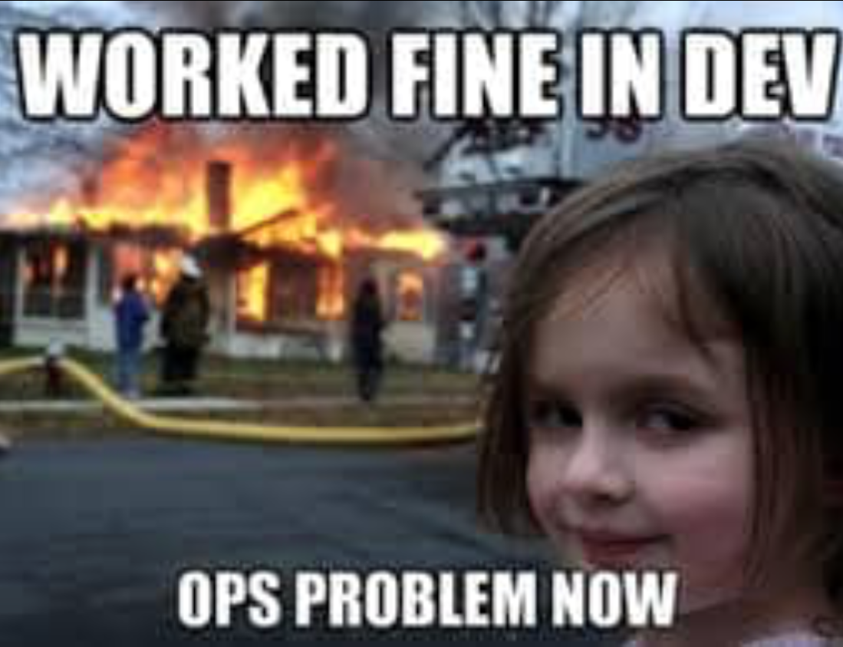
Why Test?

Slide 3
Why Test?
Code does what it’s supposed to
Doesn’t work for only one user
Users make mistakes
Compatibility
Deliver quality software

Slide 4
The DevOps Paradigm
Continuous Development
Source
Build
Test
Release
Rinse and Repeat

Slide 5
What is Pester?
Ubiquitous Test Framework for PowerShell
Open Source Project
https://github.com/pester/Pester
Included in Windows 10 (Pester 3.5)
Domain-Specific Language
Example: 2 + 2 | should -beExactly 4

Slide 6
DEMO!!

Slide 7
Additional Reading
Release Pipeline: https://docs.microsoft.com/en-us/powershell/dsc/whitepapers

Slide 8
THANK YOU!!!
Follow me on Twitter! @thedevopsdiva
Don’t forget evaluations – it’s how I get to come back!! ☺

